Slide 1

Alameda County
Proposed Housing Bond!
Notes:
Thursday, March 24 – SPUR
Oakland is experiencing a housing crisis, yet there are few resources to fund affordable housing at the local level. Where might the city find new funding that can be used to keep Oakland affordable? A panel of experts discuss where this money can come from and how it should best be used.
+ Amie Fishman / Non-Profit Housing Association of Northern California
+ Joshua Simon / East Bay Asian Local Development Corporation
+ Councilmember Abel Guillén / Oakland City Council
+ Gloria Bruce / East Bay Housing Organizations
Thanks to SPUR for the invitation, to our partners at EBHO and our members at EBALDC
And to Councilmember Guillen for all that you do to create and preserve affordable homes
I want to share an exciting new strategy that NPH is working on with our partners and members

Slide 2

NPH Electoral Strategy
Pilot program for SF Prop A 11/15
Notes:
NPH is taking action
We are building public support and political will for
re-investment in housing affordability
We piloted this effort across the Bay last fall with campaigns for
- Prop A – a $310 million bond approved by 74% of voters; - Prop K – dedicating public land for affordable housing

Slide 3
Notes:
We reached out to residents to tell the Prop A & K story

Slide 4
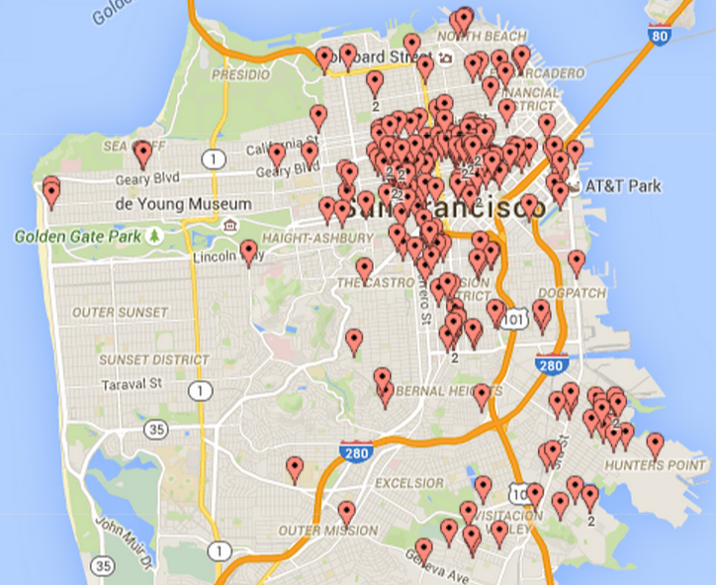
Demographics of Registered Voters in Non-Profit Housing’s San Francisco Voter Match
In September, 2015 NPH created a voter file by matching a roster of properties under members’ management to a voter file at Political Data, Inc. More than 6,000 registered voters were identified, and will be contacted with voter education and civic engagement materials.
AGE is recorded at time of first registration, and those flagged below 20 years of age, or at 99 years, may reflect recording or transcription errors. LANGUAGE and ethnicity are estimated through ballot access materials requested, nation of birth or surname filter.
Notes:
We piloted a voter database that showed 12,000 San Francisco voters in NPH member homes
Map
They live in the central and eastern sides of the City
Middle pie
Dark blue – 25% are over 70
Right pie
Light blue – About 1/3 preferred a Chinese language mail ballot

Slide 5
Notes:
And they voted in remarkable numbers.
Your know the story of voter turnout – rarely do low-income voters perform at the same rate as the general electorate, especially in low-turnout off-year elections
That shows the value of stable housing – and the reach of civic engagement activities

Slide 6
Alameda County
January 2015 Polling
Notes:
NPH is taking action
We are building public support and political will for
re-investment in housing affordability
We piloted this effort across the Bay last fall with campaigns for
- Prop A – a $310 million bond approved by 74% of voters; - Prop K – dedicating public land for affordable housing

Slide 7
Notes:
Turning our attention to the East Bay, this January NPH and EBHO partnered with Supervisor Wilma Chan to survey likely voters about a housing bond in Alameda County
If asked
500 sample
+/- 4.4%
English, Spanish, Chinese

Slide 8
Notes:
Voters support a housing bond above the required 2/3 threshold
In fact, 69% support the measure, with 65% strongly supporting and just 4% leaning yes
Please we have fabulous tools – great messages for reminding people why they support the bond

Slide 10
Notes:
You can see how the bond addresses voter concerns
Particularly serving communities of concern, seniors, people with disabilities, low-income families, veterans, young adults transitioning from foster care

Slide 11
Notes:
Acquiring land is the least popular of all these – but it’s still supported by more than 2/3 of likely voters

Slide 13
Prior Bond Campaigns
Housing 1988, Transportation 2014
Notes:
NPH is taking action
We are building public support and political will for
re-investment in housing affordability
We piloted this effort across the Bay last fall with campaigns for
- Prop A – a $310 million bond approved by 74% of voters; - Prop K – dedicating public land for affordable housing

Slide 14
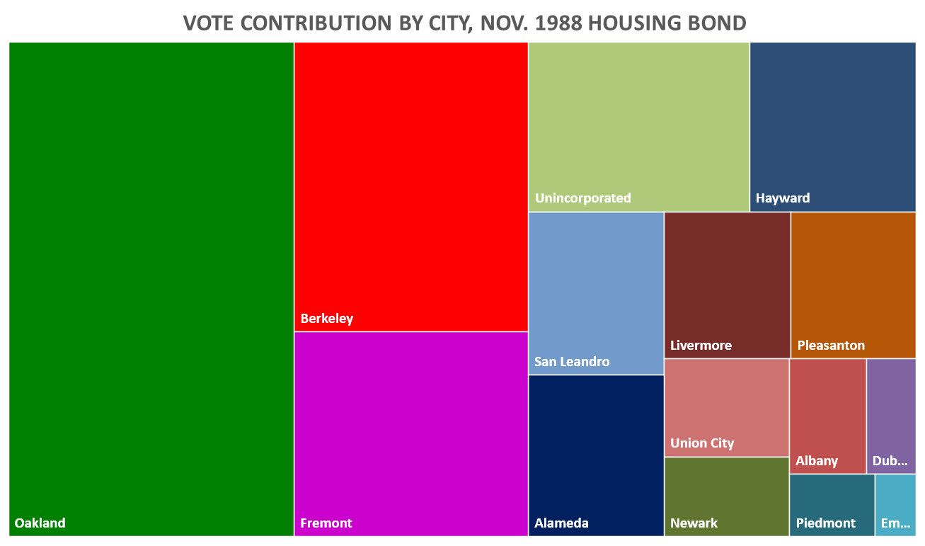
Total Votes Cast
Yes | 266,342
No | 146,591
Total Vote | 412,933
 | 64.5%
Needed votes | 6,000
Yes Votes in Each City
Alameda | 14,343
Albany | 4,396
Berkeley | 36,117
Dublin | 3,755
Emeryville | 1,416
Fremont | 32,303
Hayward | 19,218
Livermore | 11,771
Newark | 6,574
Oakland | 77,702
Piedmont | 2,660
Pleasanton | 10,510
San Leandro | 14,117
Union City | 7,905
Unincorporated | 23,555
Notes:
Who here supported the earlier Alameda County housing bonds in 1988 and 1990?
This shows you the distribution of Yes votes from our 14 cities – you can see the important role every community plays in getting above the 2/3 required

Slide 15
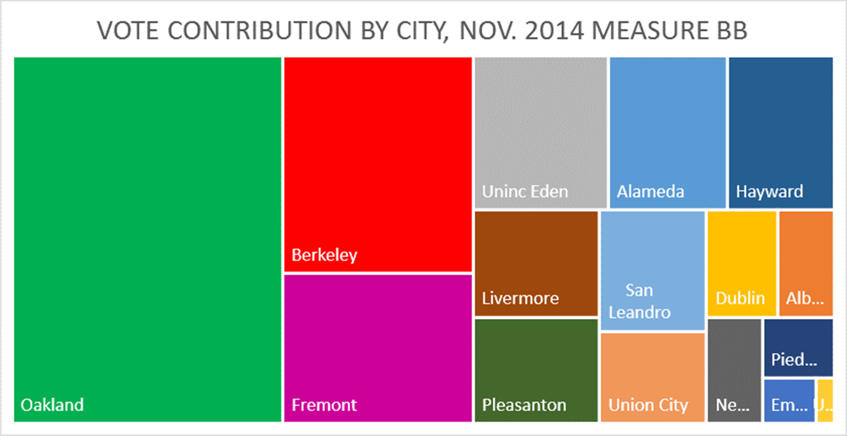
Total Votes Cast
Yes | 240,557
No | 99,417
Total Vote | 339,974
 | 70.8%
Yes Votes in Each City
ALAMEDA | 14,625
ALBANY | 4,833
BERKELEY | 33,004
DUBLIN | 6,057
EMERYVILLE | 1,922
FREMONT | 22,769
HAYWARD | 13,168
LIVERMORE | 10,752
NEWARK | 4,729
OAKLAND | 79,134
PIEDMONT | 3,446
PLEASANTON | 10,653
SAN LEANDRO | 10,343
UNION CITY | 7,852
UNINC Total | 17,270
Notes:
It’s a similar distribution to the successful transportation measure passed in 2014

Slide 16
Notes:
We thank Alameda County HCD for everything it does and for these statistics
Next slide – is the suspense building?

Slide 17
Notes:
This shows Alameda County has suffered a cut of 89% in funding for affordable home construction since the Recession
That’s right…89%
Between the wind-down of State Prop 1C funds, the dissolution of Redevelopment agencies, and federal cuts
Alameda County has lost 89%

Slide 18
Notes:
Our growing industries create many more low-wage jobs than high-wage jobs
In the tech industry, the multiplier is 3-5
That is, when Uber moves in across the street next year, you can count on 3,000 high-wage programmers with dollars to spend on housing
But another 9,000 jobs for janitors, baristas, and shuttle drivers who will be forced our of Oakland

Slide 19
2016 TIMELINE FOR ACTION
January | Polling by NPH, EBHO, Supervisor Chan
February | Poll briefings. Supervisor review.
March | Supervisors Chan, Carson, Miley kickoff Stakeholder outreach and policy development
April | Policy development by County HCD, Cities. Convene community partners
May | 5 District Town Halls Affordable Housing Week
June | Formal action by Supervisors to place on ballot City Resolutions in Support
July | Campaign committee launches (formal fundraising), hires consultant
August | Fundraising. Endorsements.
September | Campaign launch
October | Ballots mail first week
November | Tuesday, Nov. 8, 2016 – Election Day
Notes:
Here’s where we go next
County Supervisors have voted unanimously 4 times to move each piece ahead.
They are targeting June 14 for action to place a measure before voters on November 8
They will host town halls, workshop sessions, and stakeholder meetings spring

Slide 20
What it takes to win
Community consensus
Disciplined messaging
Strong public engagement prior to placement on ballot
Resources
Resident voices
You!
Notes:
We can see a path to a successful campaign if the community pulls together and educates the public that we don’t just have a housing affordability crisis
-- we also have solutions

Slide 21
Thank You & Let’s Win!
Sharon Cornu
@SharonCornuNPH
Sharon@NonProfitHousing.org

